Slide 1
ENPM 667 Project 1: Enhanced Bioinspired Backstepping Control for a Mobile Robot with Unscented Kalman Filter
Jayesh Jayashankar (117450101)
Aneesh Chodisetty (117359893)

Slide 2
Introduction
The objectives as part of this project are to ensure that a mobile robot does not change its direction as it travels along a straight path by combining a bioinspired backstepping controller and a torque controller.
A Kalman filter and an Unscented Kalman filter is used to ensure that the desired position is close to the estimated position.
The stability is ensured by the Lyapunov stability analysis.

Slide 3
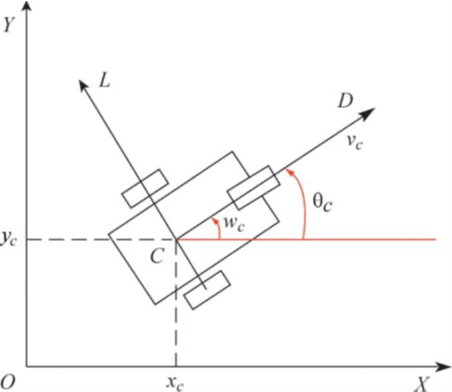
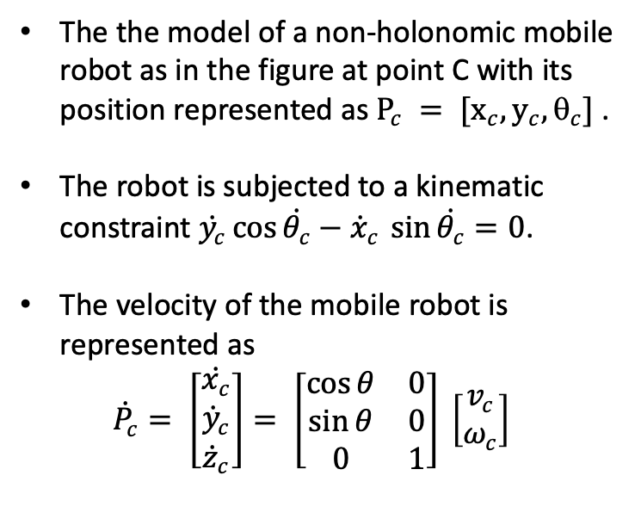
Kinematics of a Non-Holonomic Mobile Robot
The the model of a non-holonomic mobile robot as in the figure at point C with its position represented as $P_{c} = [x_{c}, y_{c}, _{c}]$ .
The robot is subjected to a kinematic constraint $\dot{y_{c}}\cos{\dot{θ_{c}}}−{\dot{x}}_{c }\sin{\dot{θ_{c}}}=0$.
The velocity of the mobile robot is represented as
$${\dot{P}}_{c}= \left[\begin{matrix}\dot{x_{c}} \\ {\dot{y}}_{c} \\ {\dot{z}}_{c}\end{matrix}\right]= \left[\begin{matrix}\cos{θ} & 0 \\ \sin{θ} & 0 \\ 0 & 1\end{matrix}\right] \left[\begin{matrix}v_{c} \\ ω_{c}\end{matrix}\right]$$

Slide 4
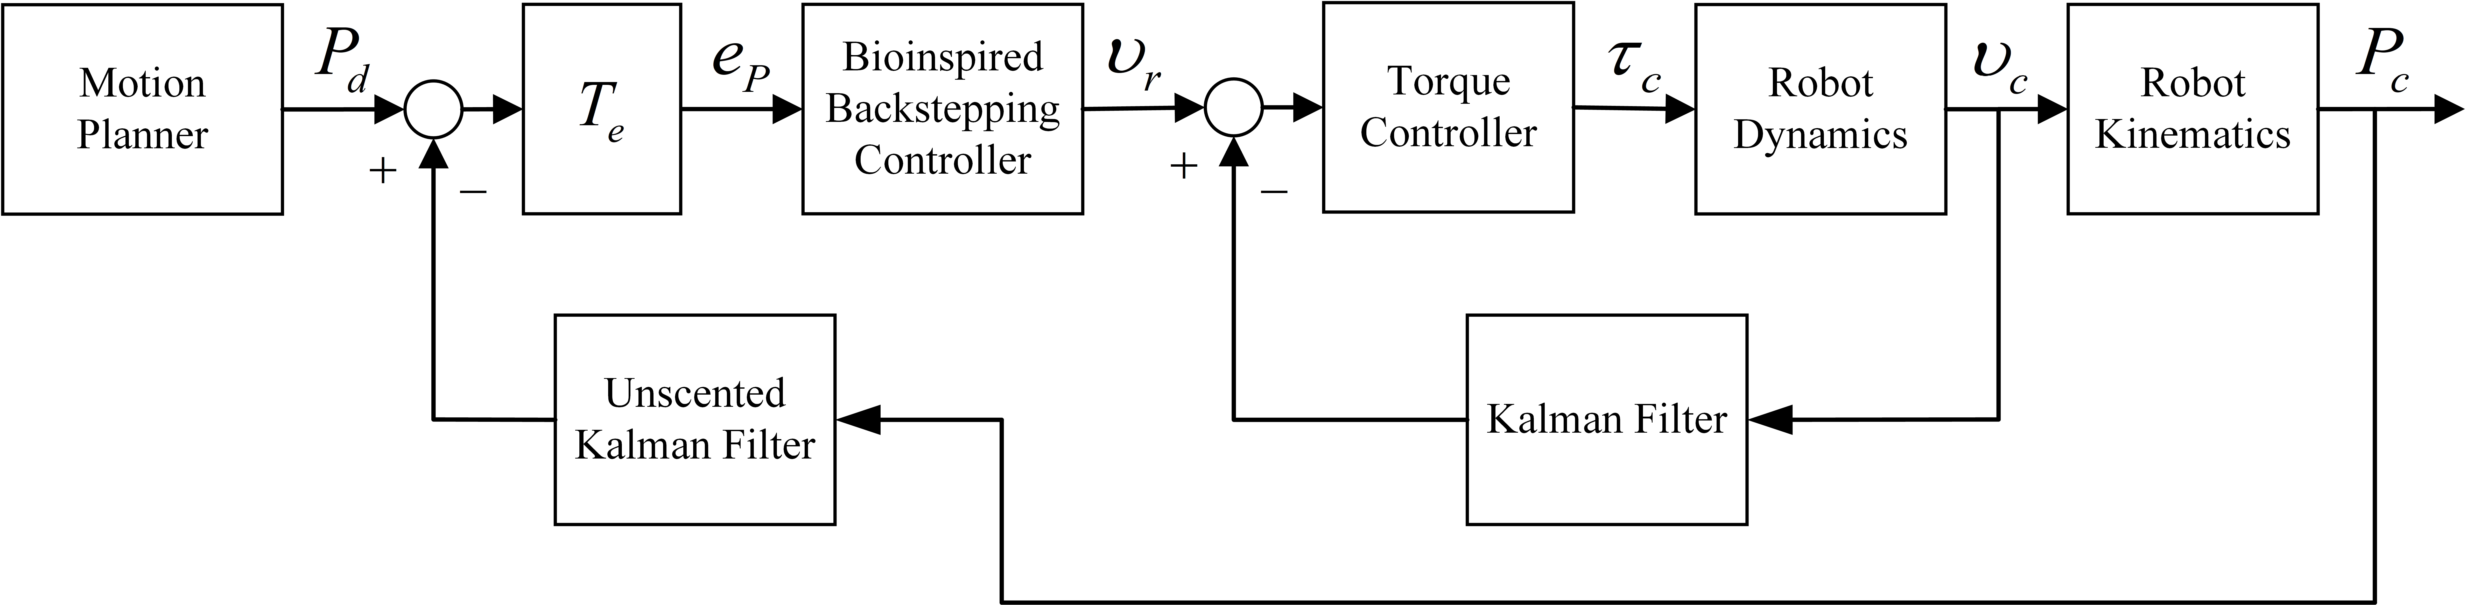
Control Strategy
The below diagram depicts the control strategy for the mobile robot using the bioinspired backstepping controller and the torque controller.
A Kalman filter is used to control the linear velocity of the mobile robot.
The unscented Kalman filter uses this information to control the position of the mobile robot.

Slide 5
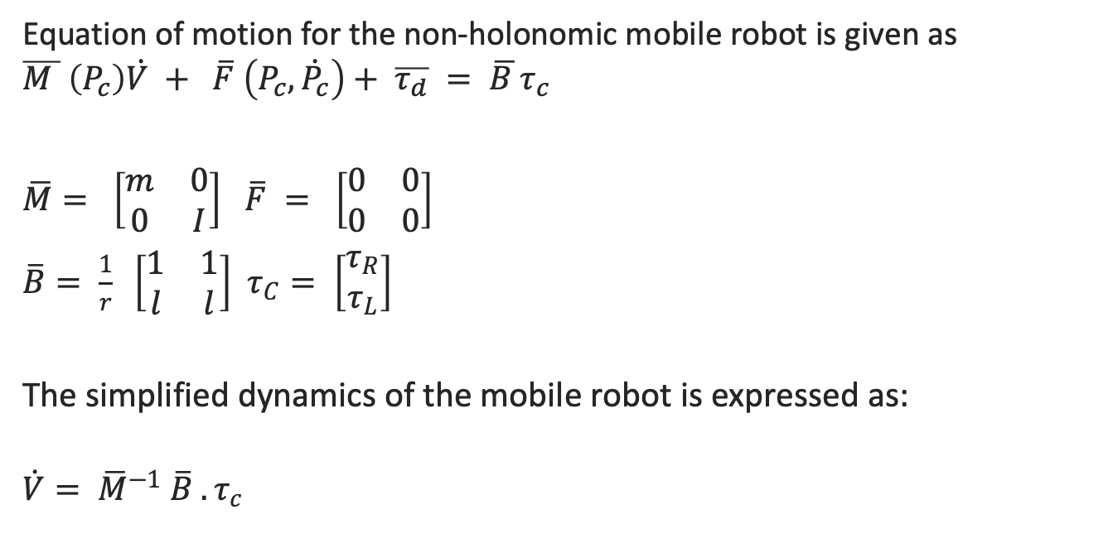
Robot Dynamics
Equation of motion for the non-holonomic mobile robot is given as
$$\overline{M } \left(P_{c}\right)\dot{V }+ \overline{F} \left(P_{c}, \dot{P_{c}}\right)+ \overline{τ_{d}} = \overline{B }τ_{c}$$
$\overline{M}= \left[\begin{matrix}m & 0 \\ 0 & I\end{matrix}\right]$ $\overline{F} = \left[\begin{matrix}0 & 0 \\ 0 & 0\end{matrix}\right]$
$\overline{B}= \frac{1}{r} \left[\begin{matrix}1 & 1 \\ l & l\end{matrix}\right]$ $τ_{C}= \left[\begin{matrix}τ_{R} \\ τ_{L}\end{matrix}\right]$
The simplified dynamics of the mobile robot is expressed as:
$$\dot{V}= {\overline{M}}^{−1} \overline{B} . τ_{c}$$

Slide 6
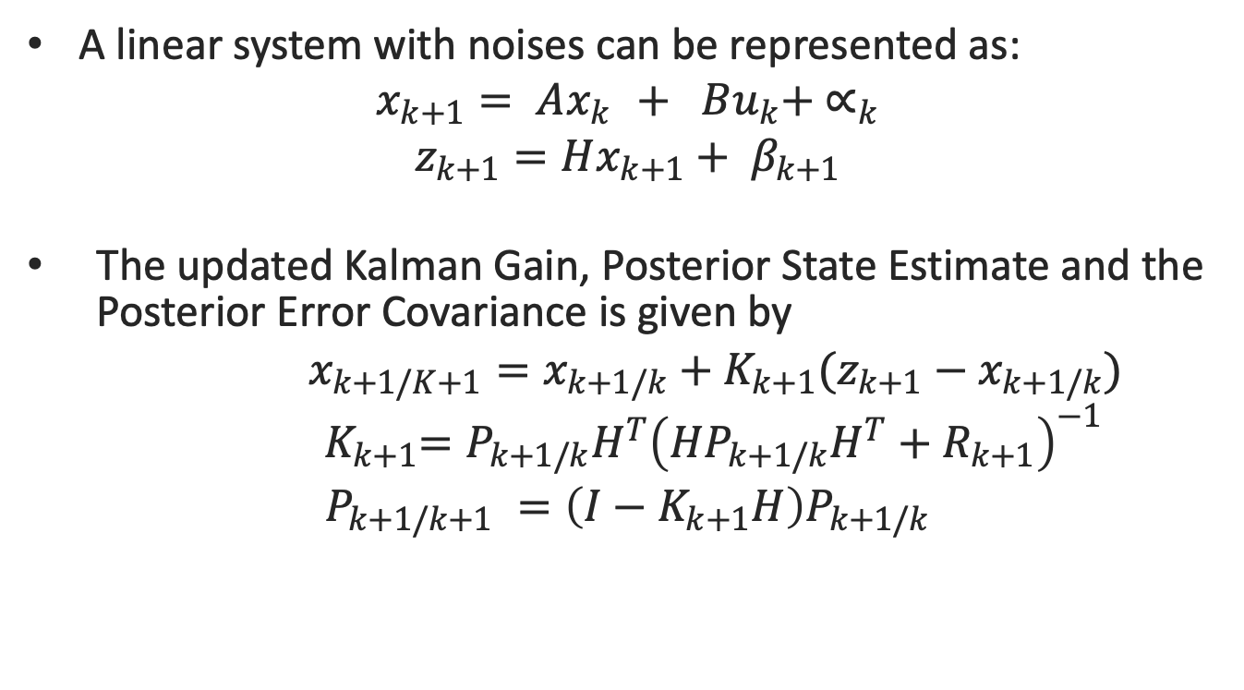
Kalman Filter
A linear system with noises can be represented as:
$x_{k+1}= Ax_{k }+ Bu_{k}+ ∝_{k}$
$z_{k+1}=Hx_{k+1}+ β_{k+1}$
The updated Kalman Gain, Posterior State Estimate and the Posterior Error Covariance is given by
$x_{k+1/K+1}=x_{k+1/k}+K_{k+1}(z_{k+1}−x_{k+1/k})$
$${ K}_{k+1}=P_{k+1/k}H^{T}{\left(HP_{k+1/k}H^{T}+R_{k+1}\right)}^{−1}$$
$P_{k+1/k+1} =\left(I−K_{k+1}H\right)P_{k+1/k}$

Slide 7
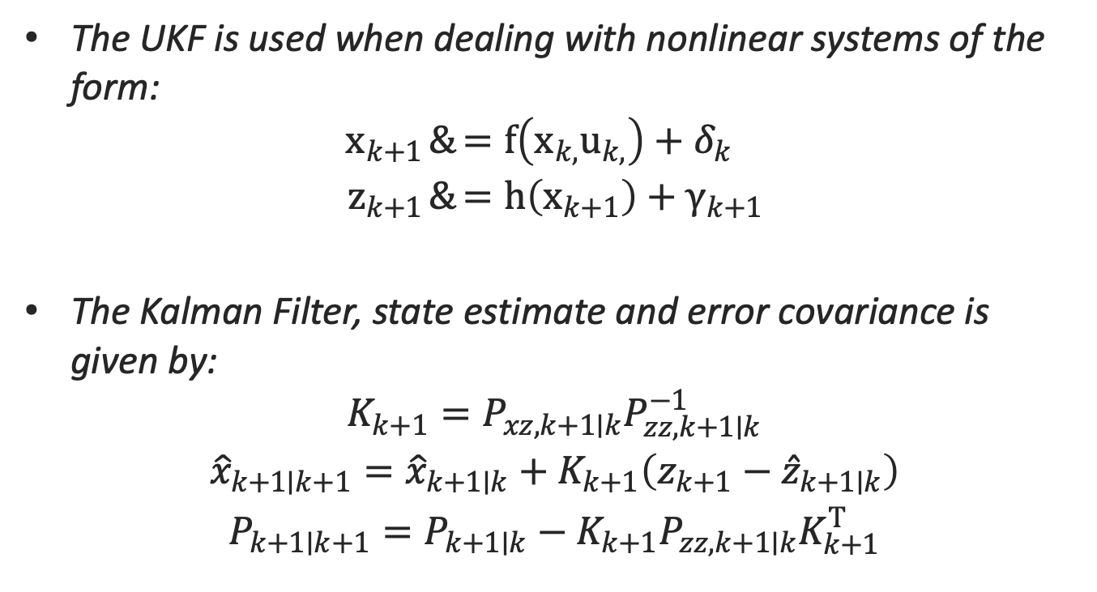
Unscented Kalman Filter
The UKF is used when dealing with nonlinear systems of the form:
$$\begin{aligned}x_{k+1}&=f\left(x_{k,}u_{k,}\right)+δ_{k} \\ z_{k+1}&=h\left(x_{k+1}\right)+γ_{k+1}\end{aligned}$$
The Kalman Filter, state estimate and error covariance is given by:
$$\begin{aligned}K_{k+1}=P_{xz,k+1∣k}P_{zz,k+1∣k}^{−1} \\ {\hat{x}}_{k+1∣k+1}={\hat{x}}_{k+1∣k}+K_{k+1}\left(z_{k+1}−{\hat{z}}_{k+1∣k}\right) \\ P_{k+1∣k+1}=P_{k+1∣k}−K_{k+1}P_{zz,k+1∣k}K_{k+1}^{T}\end{aligned}$$

Slide 8
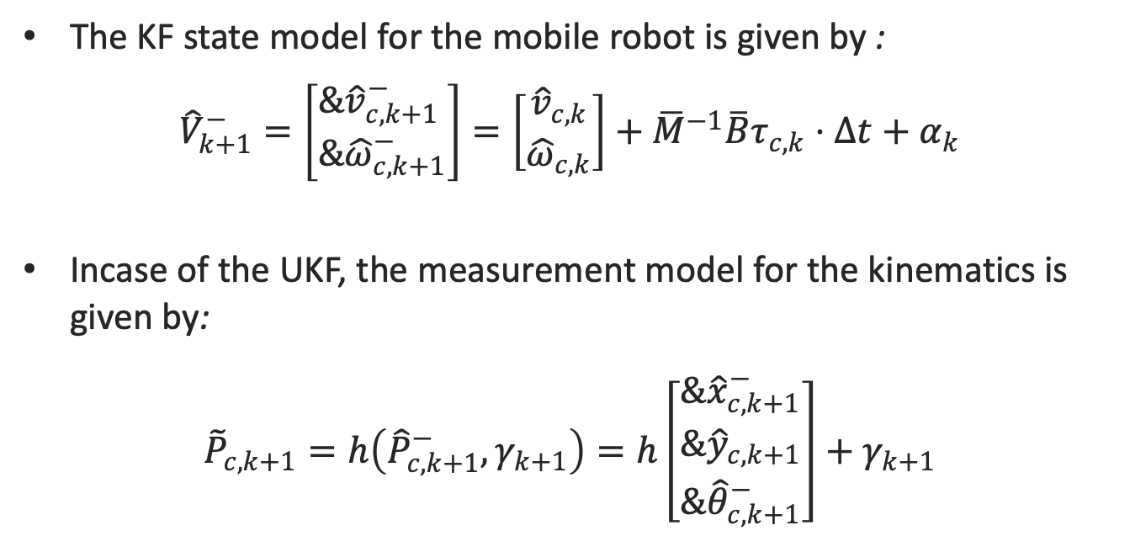
KF and UKF for the mobile robot
The KF state model for the mobile robot is given by :
${\hat{V}}_{k+1}^{−}=\left[\begin{aligned}&{\hat{v}}_{c,k+1}^{−} \\ &{\hat{ω}}_{c,k+1}^{−}\end{aligned}\right]=\left[\begin{aligned}{\hat{v}}_{c,k} \\ {\hat{ω}}_{c,k}\end{aligned}\right]+{\overline{M}}^{−1}\overline{B}τ_{c,k}⋅Δt+α_{k}$
Incase of the UKF, the measurement model for the kinematics is given by:
${\tilde{P}}_{c,k+1}=h\left({\hat{P}}_{c,k+1}^{−},γ_{k+1}\right)=h\left[\begin{aligned}&{\hat{x}}_{c,k+1}^{−} \\ &{\hat{y}}_{c,k+1} \\ &{\hat{θ}}_{c,k+1}^{−}\end{aligned}\right]+γ_{k+1}$

Slide 9
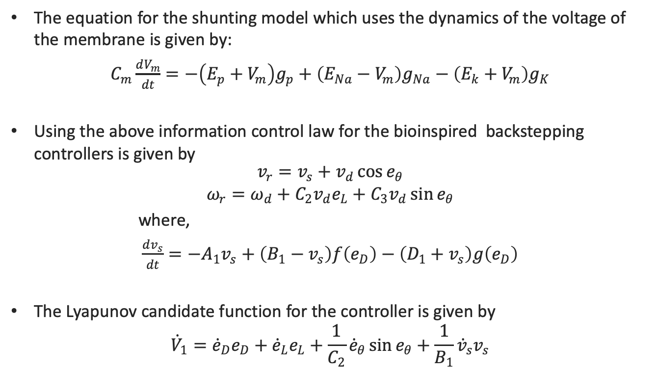
Bioinspired Backstepping Controller
The equation for the shunting model which uses the dynamics of the voltage of the membrane is given by:
$C_{m}\frac{dV_{m}}{dt}=−\left(E_{p}+V_{m}\right)g_{p}+\left(E_{Na}−V_{m}\right)g_{Na}−\left(E_{k}+V_{m}\right)g_{K}$
Using the above information control law for the bioinspired backstepping controllers is given by
$$\begin{aligned}v_{r}=v_{s}+v_{d}\cos{e_{θ}} \\ ω_{r}=ω_{d}+C_{2}v_{d}e_{L}+C_{3}v_{d}\sin{e_{θ}}\end{aligned}$$
where,
$\frac{dv_{s}}{dt}=−A_{1}v_{s}+\left(B_{1}−v_{s}\right)f\left(e_{D}\right)−\left(D_{1}+v_{s}\right)g\left(e_{D}\right)$
The Lyapunov candidate function for the controller is given by
$${\dot{V}}_{1}={\dot{e}}_{D}e_{D}+{\dot{e}}_{L}e_{L}+\frac{1}{C_{2}}{\dot{e}}_{θ}\sin{e_{θ}}+\frac{1}{B_{1}}{\dot{v}}_{s}v_{s}$$

Slide 10
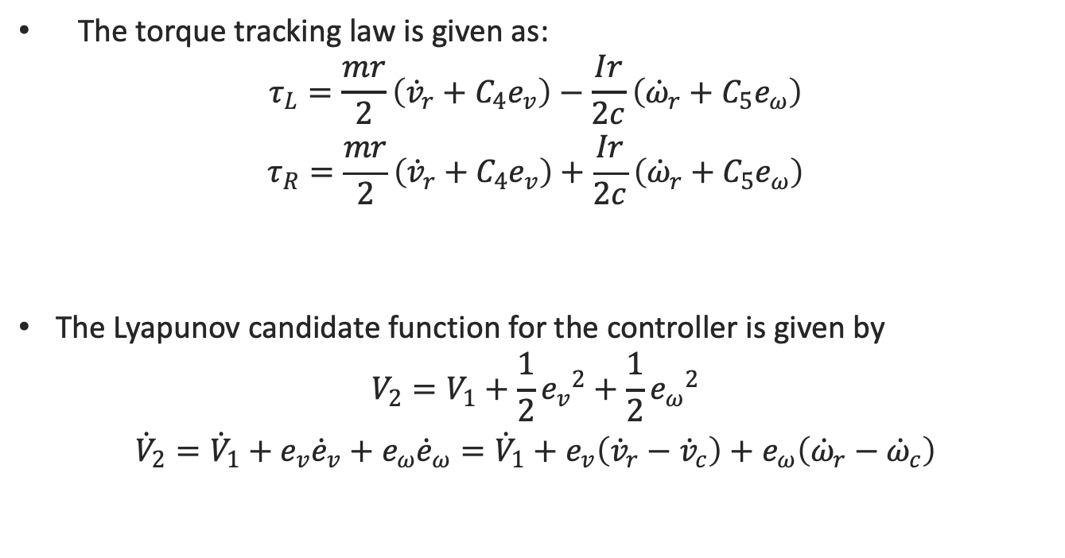
Torque Controller
The torque tracking law is given as:
$$\begin{aligned}τ_{L}=\frac{mr}{2}\left({\dot{v}}_{r}+C_{4}e_{v}\right)−\frac{Ir}{2c}\left({\dot{ω}}_{r}+C_{5}e_{ω}\right) \\ τ_{R}=\frac{mr}{2}\left({\dot{v}}_{r}+C_{4}e_{v}\right)+\frac{Ir}{2c}\left({\dot{ω}}_{r}+C_{5}e_{ω}\right)\end{aligned}$$
The Lyapunov candidate function for the controller is given by
$$\begin{aligned}V_{2}=V_{1}+\frac{1}{2}{e_{v}}^{2}+\frac{1}{2}{e_{ω}}^{2} \\ {\dot{V}}_{2}={\dot{V}}_{1}+e_{v}{\dot{e}}_{v}+e_{ω}{\dot{e}}_{ω}={\dot{V}}_{1}+e_{v}\left({\dot{v}}_{r}−{\dot{v}}_{c}\right)+e_{ω}\left({\dot{ω}}_{r}−{\dot{ω}}_{c}\right)\end{aligned}$$

Slide 11
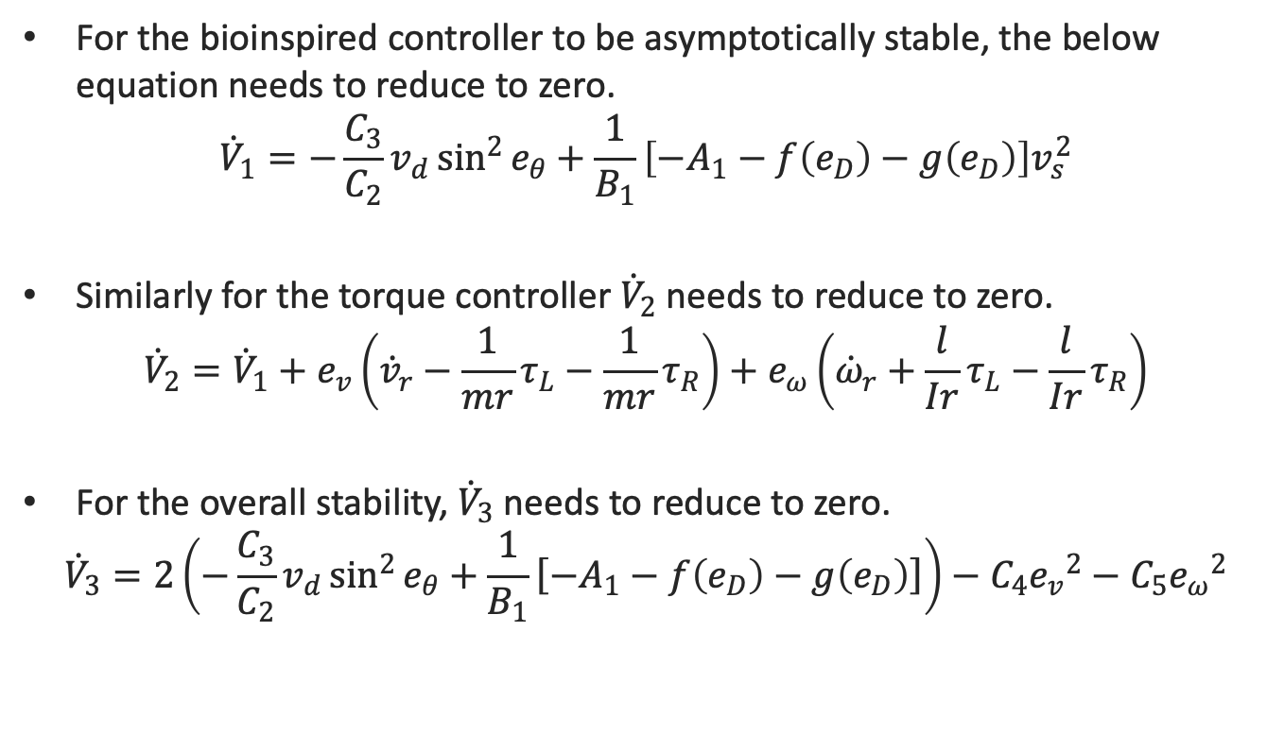
Stability Analysis
For the bioinspired controller to be asymptotically stable, the below equation needs to reduce to zero.
$${\dot{V}}_{1}=−\frac{C_{3}}{C_{2}}v_{d}\sin^{2}{e_{θ}}+\frac{1}{B_{1}}\left[−A_{1}−f\left(e_{D}\right)−g\left(e_{D}\right)\right]v_{s}^{2}$$
Similarly for the torque controller ${\dot{V}}_{2}$ needs to reduce to zero.
$${\dot{V}}_{2}={\dot{V}}_{1}+e_{v}\left({\dot{v}}_{r}−\frac{1}{mr}τ_{L}−\frac{1}{mr}τ_{R}\right)+e_{ω}\left({\dot{ω}}_{r}+\frac{l}{Ir}τ_{L}−\frac{l}{Ir}τ_{R}\right)$$
For the overall stability, ${\dot{V}}_{3}$ needs to reduce to zero.
$${\dot{V}}_{3}=2\left(−\frac{C_{3}}{C_{2}}v_{d}\sin^{2}{e_{θ}}+\frac{1}{B_{1}}\left[−A_{1}−f\left(e_{D}\right) \left.− g\left(e_{D}\right)\right]\right.\right)−C_{4}{e_{v}}^{2}−C_{5}{e_{ω}}^{2}$$

Slide 12
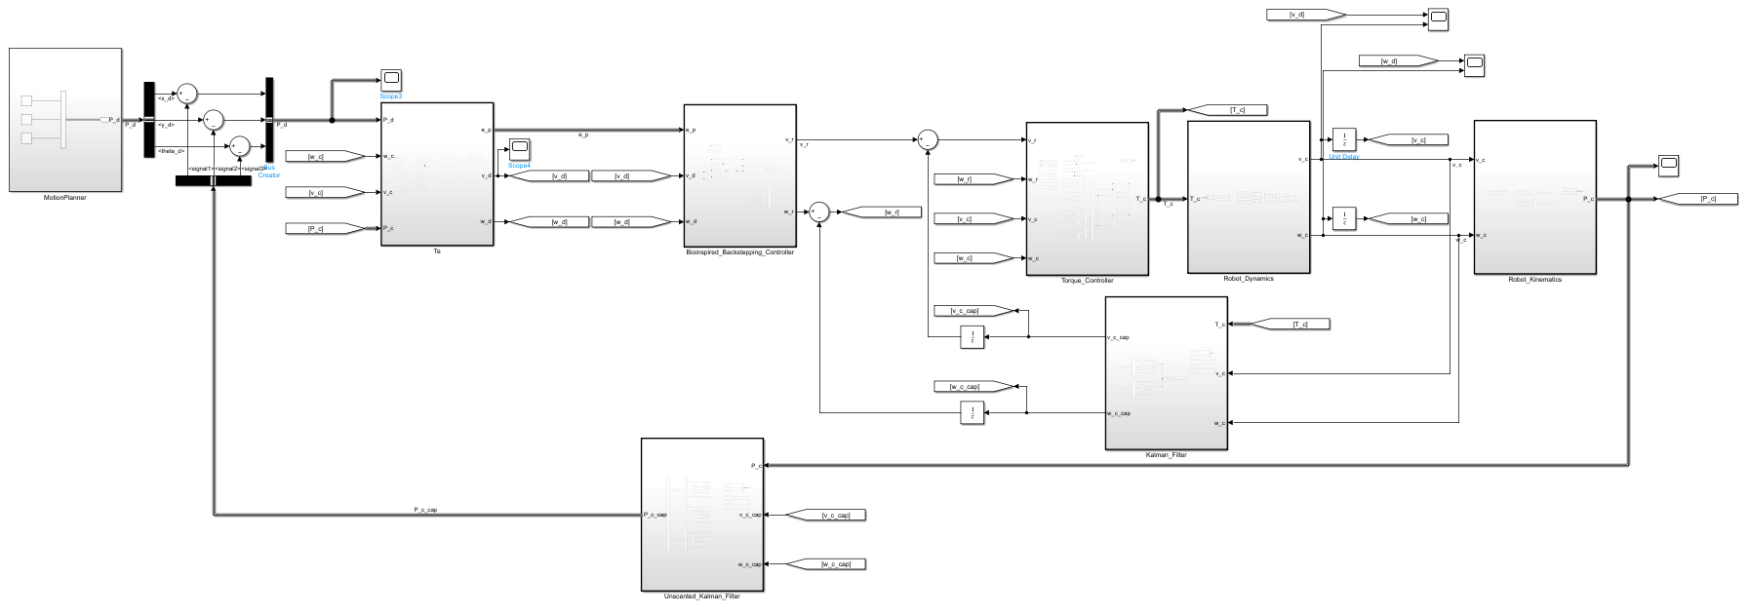
SIMULINK Model

Slide 13
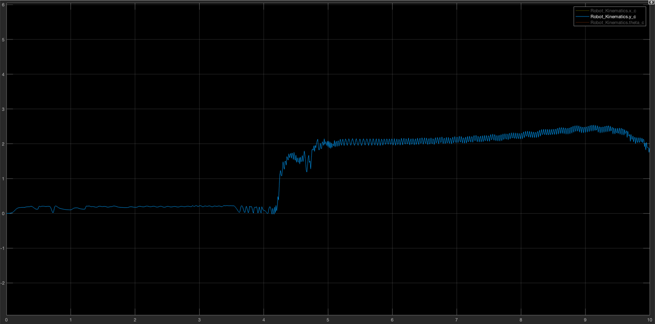
Plot tracking the position of the mobile robot
The desired posture of the robot is x=0, y=4. The estimated position for our model increases upto y=2.5 and saturates.

Slide 14
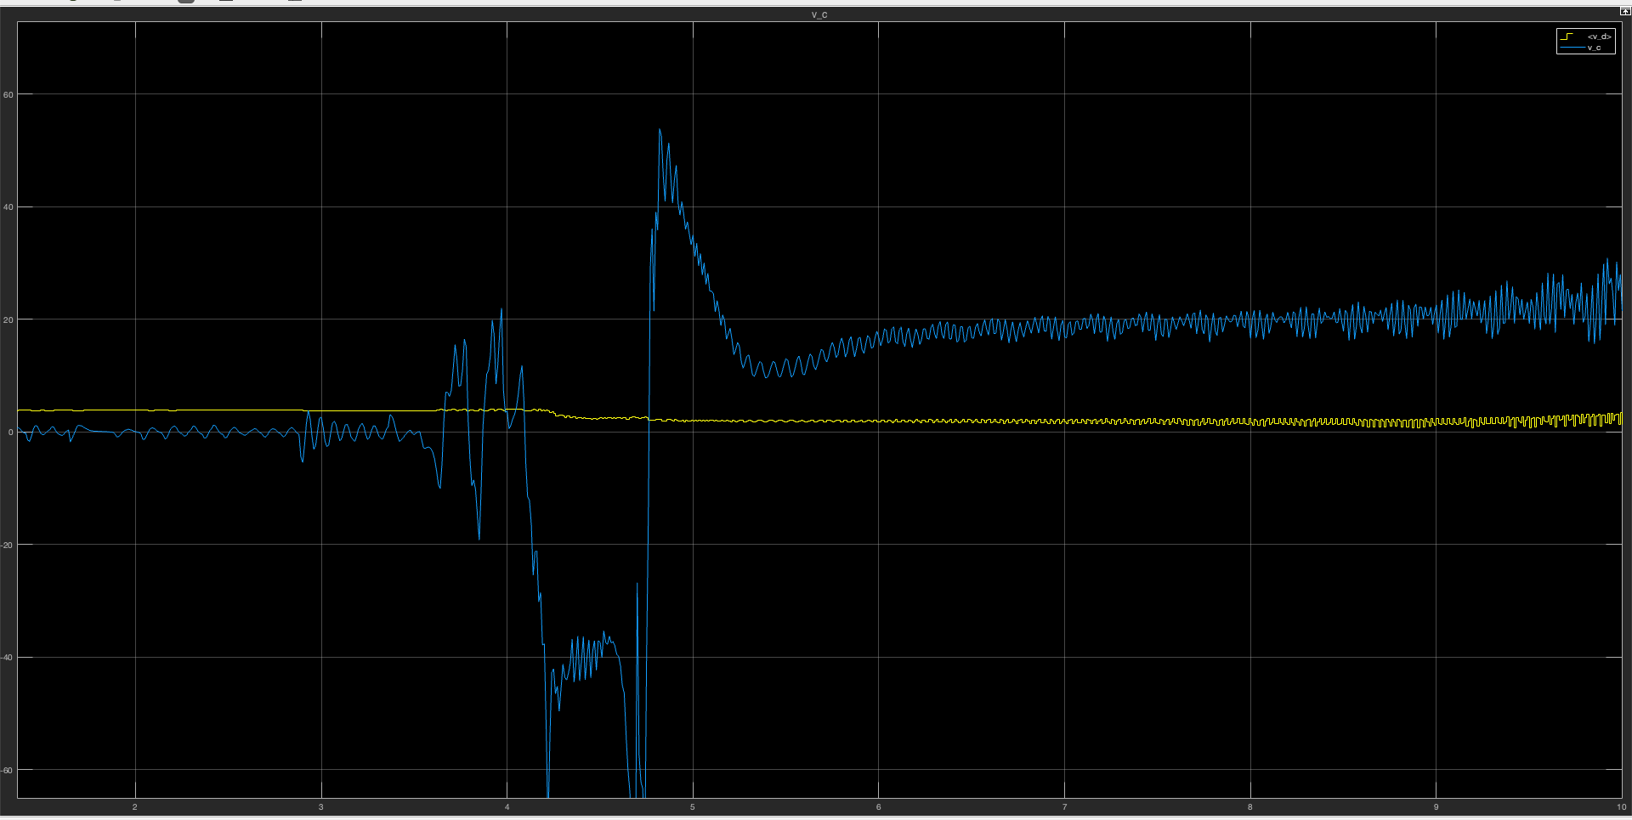
Plot comparing the estimated linear velocity with the desired linear velocity

Slide 15
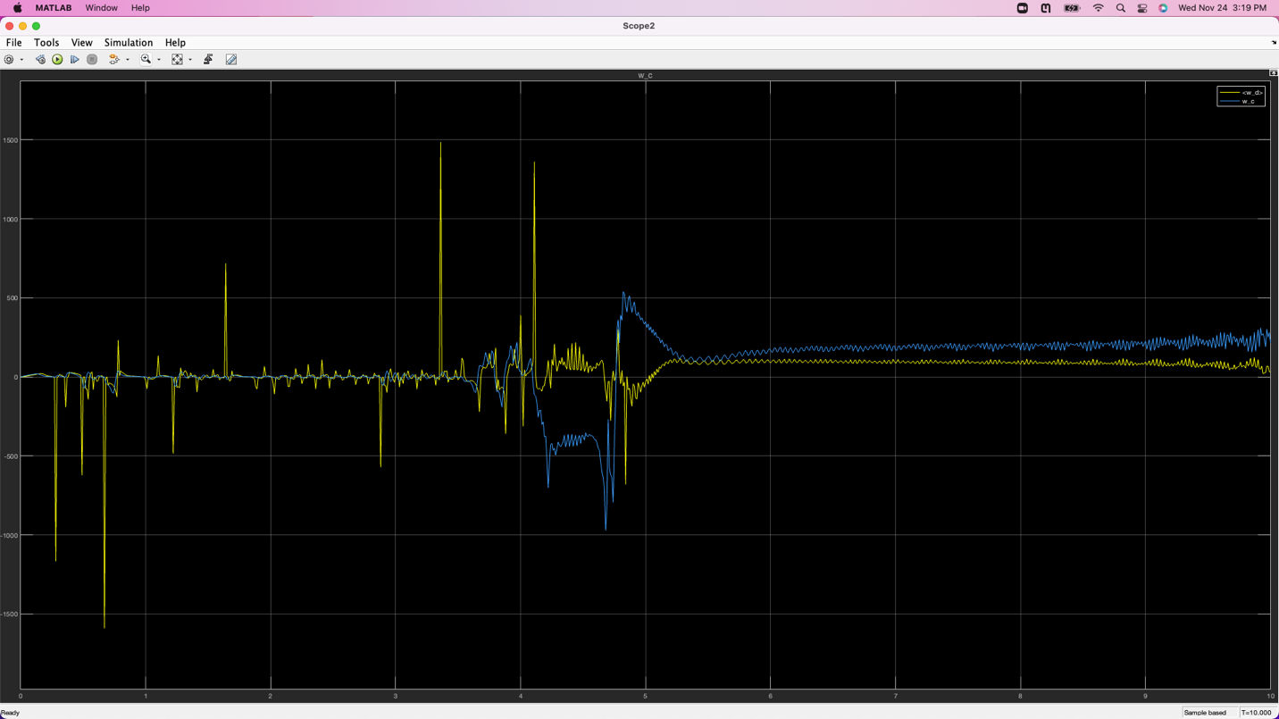
Plot comparing the estimated angular velocity with the desired angular velocity

Slide 16
Conclusion
The project covers a control strategy to track the direction of the mobile robot when travelling in a straight line using a bioinspired approach.
Two controllers have been implemented one is a backstepping controller and the other is a torque controller. The equations describing the various blocks of the model have been derived.
The controller model has been designed in Simulink based on the equations of the subsections of the model and simulation has been carried out to track the position of the robot, linear and angular velocity of the mobile robot over a period of time.

Slide 17
References
1. Z. Xu, S. X. Yang and S. A. Gadsden, "Enhanced Bioinspired Backstepping Control for a Mobile Robot With Unscented Kalman Filter," in IEEE Access, vol. 8, pp. 125899-125908, 2020, doi: 10.1109/ACCESS.2020.3007881.
2. https://web.mit.edu/kirtley/kirtley/binlustuff/literature/control/Kalman%20filter.pdf
3. https://stanfordasl.github.io/aa274a/pdfs/notes/lecture1.pdf
4. http://www.cpdee.ufmg.br/~torres/wp-content/uploads/2018/02/nonholonomic_constraints.pdf
5. https://www.hilarispublisher.com/open-access/dynamic-modelling-of-differentialdrive-mobile-robots-using-lagrange-and-newtoneuler-methodologies-a-unified-framework-2168-9695.1000107.pdf
6. https://stats.stackexchange.com/questions/86075/kalman-filter-equation-derivation
7. https://missingueverymoment.wordpress.com/2019/12/02/derivation-of-kalman-filter/
8. https://www.cse.sc.edu/~terejanu/files/tutorialUKF.pdf
9. https://groups.seas.harvard.edu/courses/cs281/papers/unscented.pdf
10. https://math.stackexchange.com/questions/3066305/derivation-of-kalman-gain-for-the-unscented-kalman-filter-ukf

